Slide 1
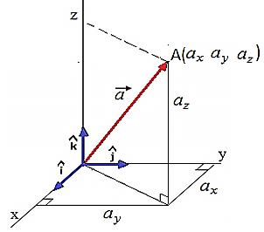
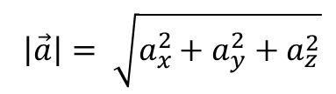
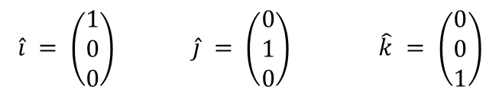

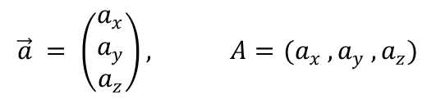
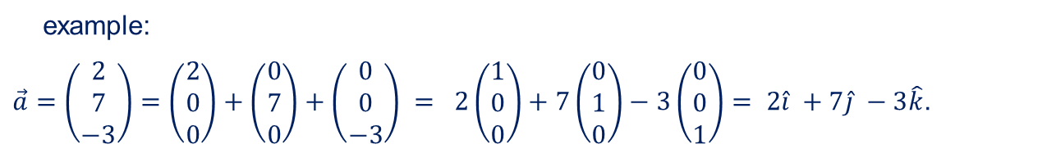
VECTORS IN COMPONENT FORM
Vector as position vector of point A in 3 – D in Cartesian coordinate system:
$$\vec{a} = a_{x}\hat{i} + a_{y}\hat{j} + a_{z}\hat{k} ≡ \left(\begin{matrix}a_{x} \\ a_{y} \\ a_{z}\end{matrix}\right) ≡ \left(\begin{matrix}a_{x} & a_{y} & a_{z}\end{matrix}\right)$$
where $\hat{i}, \hat{j} and \hat{k}$ are unit vectors in x, y and z directions.
$\hat{i} = \left(\begin{matrix}1 \\ 0 \\ 0\end{matrix}\right) \hat{j} = \left(\begin{matrix}0 \\ 1 \\ 0\end{matrix}\right) \hat{k} = \left(\begin{matrix}0 \\ 0 \\ 1\end{matrix}\right)$
Both, position vector of point A and point A have the same coordinates:
$$\vec{a} = \left(\begin{matrix}a_{x} \\ a_{y} \\ a_{z}\end{matrix}\right), A=(a_{x} , a_{y} , a_{z})$$
$$\left|\vec{a}\right|= \sqrt{a_{x}^{2}+a_{y}^{2}+a_{z}^{2}}$$
$$\left|\vec{a}\right| is called magnitude, length, modulus or norm$$
example:
$\vec{a}=\left(\begin{matrix}2 \\ 7 \\ −3\end{matrix}\right)=\left(\begin{matrix}2 \\ 0 \\ 0\end{matrix}\right)+\left(\begin{matrix}0 \\ 7 \\ 0\end{matrix}\right)+\left(\begin{matrix}0 \\ 0 \\ −3\end{matrix}\right) = 2\left(\begin{matrix}1 \\ 0 \\ 0\end{matrix}\right)+7\left(\begin{matrix}0 \\ 1 \\ 0\end{matrix}\right)−3\left(\begin{matrix}0 \\ 0 \\ 1\end{matrix}\right)= 2\hat{i} +7\hat{j} −3\hat{k}$.

Slide 2
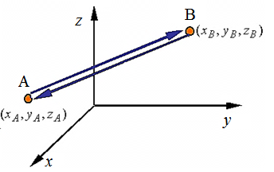
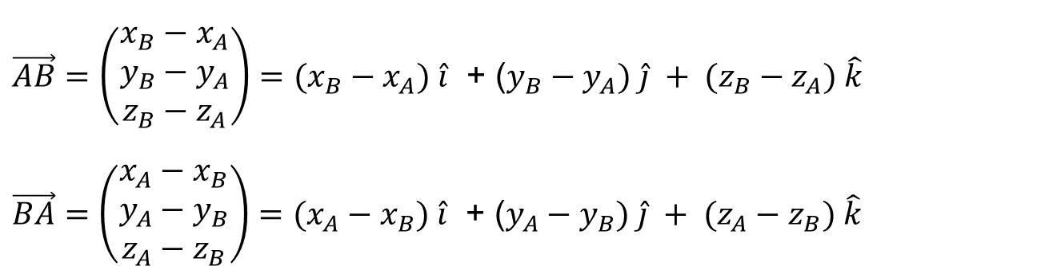
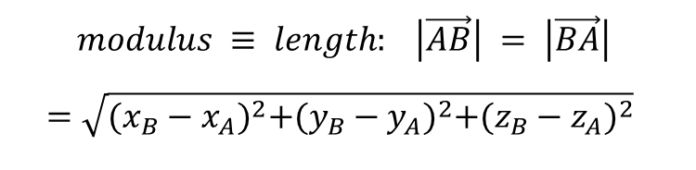
VECTOR BETWEEN TWO POINTS
$\vec{AB}=\left(\begin{matrix}x_{B}−x_{A} \\ y_{B}−y_{A} \\ z_{B}−z_{A}\end{matrix}\right)=(x_{B}−x_{A}) \hat{i}$ + ($y_{B}−y_{A}) \hat{j} + (z_{B}−z_{A}) \hat{k}$
$\vec{BA}=\left(\begin{matrix}x_{A}−x_{B} \\ y_{A}−y_{B} \\ z_{A}−z_{B}\end{matrix}\right)=(x_{A}−x_{B}) \hat{i}$ + ($y_{A}−y_{B}) \hat{j} + (z_{A}−z_{B}) \hat{k}$
$$modulus ≡ length: \left|\vec{AB}\right| = \left|\vec{BA}\right|$$
$$=\sqrt{{(x_{B}−x_{A})}^{2}+{(y_{B}−y_{A})}^{2}+{(z_{B}−z_{A})}^{2}}$$

Slide 3
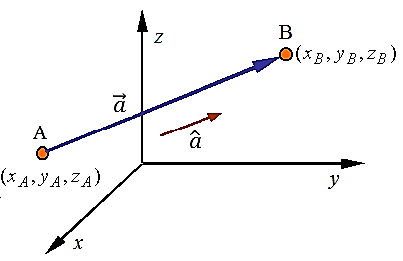
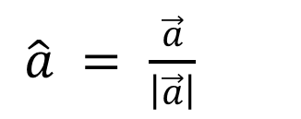


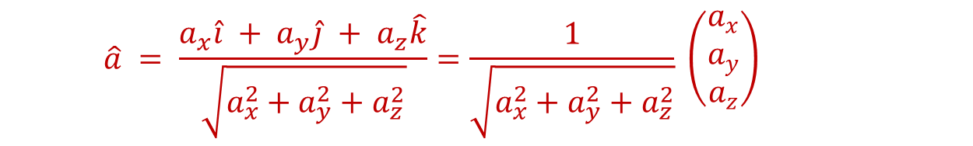
Unit vector
Definition
It gives direction only!
A unit vector is a vector whose length is 1.
For a vector $\vec{a}$, a unit vector is in the
same direction as $\vec{a}$ and is given by:
$\hat{a} =$ $\frac{\vec{a}}{\left|\vec{a}\right|}$
$$\begin{matrix}a_{x}=(x_{B}−x_{A}) \\ a_{y}=(y_{B}−y_{A}) \\ a_{z}=(z_{B}−z_{A})\end{matrix}$$
$$\hat{a} = \frac{a_{x}\hat{i} + a_{y}\hat{j} + a_{z}\hat{k}}{\sqrt{a_{x}^{2}+a_{y}^{2}+a_{z}^{2}}}=\frac{1}{\sqrt{a_{x}^{2}+a_{y}^{2}+a_{z}^{2}}} \left(\begin{matrix}a_{x} \\ a_{y} \\ a_{z}\end{matrix}\right)$$

Slide 4
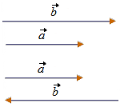
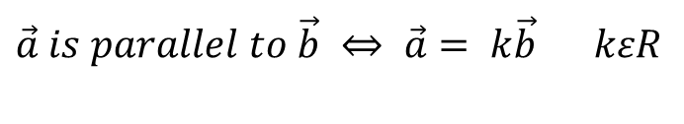
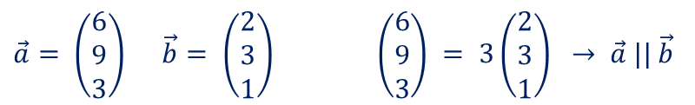
PARALLEL and COLLINEAR VECTORS
$\vec{a} is parallel to \vec{b} ⇔ \vec{a}= k\vec{b}$ $kεR$
$\vec{a}= \left(\begin{matrix}6 \\ 9 \\ 3\end{matrix}\right) \vec{b}= \left(\begin{matrix}2 \\ 3 \\ 1\end{matrix}\right)$ $\left(\begin{matrix}6 \\ 9 \\ 3\end{matrix}\right) = 3\left(\begin{matrix}2 \\ 3 \\ 1\end{matrix}\right) → \vec{a} || \vec{b}$
$$Points are collinear if they lie on the same line$$
$A, B and C are collinear$ $⇔$ $\vec{AB}=k\vec{AC} for some scalar k$
$$(one common point and the same direction)$$

Slide 5

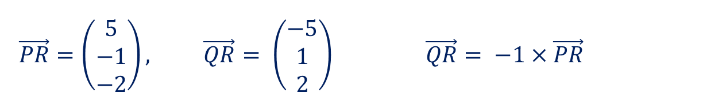
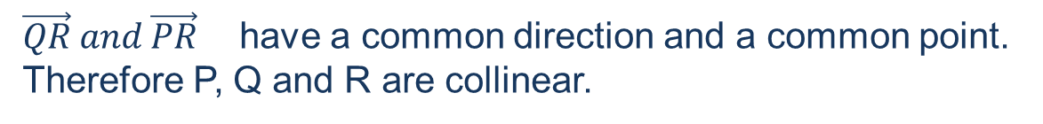
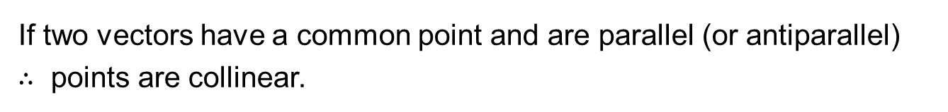
ARE 3 POINTS COLLINEAR ?
How can you check it:
Form two vectors with these three points.
They will definitely have one common point.
Check if these two vectors are parallel.
If two vectors have a common point and are parallel (or antiparallel)
$∴$ points are collinear.
Show that P(0, 2, 4), Q(10, 0, 0) and R(5, 1, 2) are collinear.
$$\vec{PR}=\left(\begin{matrix}5 \\ −1 \\ −2\end{matrix}\right), \vec{QR}= \left(\begin{matrix}−5 \\ 1 \\ 2\end{matrix}\right) \vec{QR}= −1×\vec{PR}$$
$\vec{QR} and \vec{PR}$ have a common direction and a common point.
Therefore P, Q and R are collinear.

Slide 6

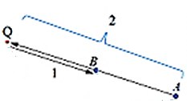

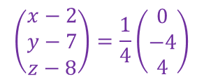
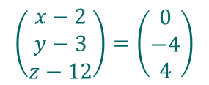

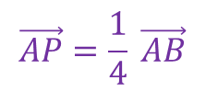

THE DIVISION OF A LINE SEGMENT
X divides [AB]$≡\overline{\text{AB}}$ in the ratio $a:b$ means $\vec{AX}:\vec{XB}=a :b$
A = (2, 7, 8) B = ( 2, 3, 12)
INTERNAL DIVISION
$$\vec{AP}=\frac{1}{4} \vec{AB}$$
P divides [AB] internally
in ratio 1:3. Find P
$$\left(\begin{matrix}x−2 \\ y−7 \\ z−8\end{matrix}\right)=\frac{1}{4}\left(\begin{matrix}0 \\ −4 \\ 4\end{matrix}\right)$$
$$\vec{AP}:\vec{PB}=1:3 → \vec{AP}=\frac{1}{4} \vec{AB}$$
point P is (2, 6, 9)
EXTERNAL DIVISION
X divide [AB] externally in ratio 2:1,
or
X divide [AB] in ratio –2:1. Find Q
$$\vec{BQ}=\vec{AB}$$
$$\left(\begin{matrix}x−2 \\ y−3 \\ z−12\end{matrix}\right)=\left(\begin{matrix}0 \\ −4 \\ 4\end{matrix}\right)$$
$$\vec{AQ}:\vec{QB}=−2:1$$
point Q is (2,– 1,16)

Slide 7








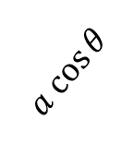

DOT/SCALAR PRODUCT
Scalar: $± number$
Definition
The dot/scalar product of two vectors $\vec{a}$and $\vec{b}$ is:
$$\vec{b}$$
$$\vec{a} • \vec{b}= \vec{b} • \vec{a} =\left|\vec{a}\right|\left|\vec{b}\right|\cos{θ}$$
θ
$$\vec{a}$$
or: Product of the length of one of them and
projection of the other one on the first one
$$\vec{b}$$
$$a cos{θ}$$
$$\vec{b}$$
$$\vec{a}$$
$$b cos{θ}$$
$$\vec{a}$$

Slide 8
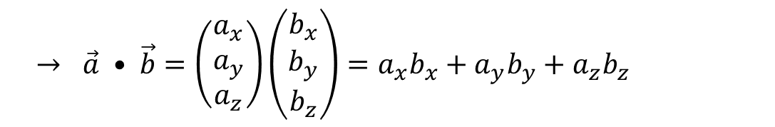
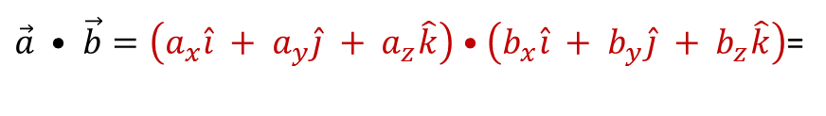
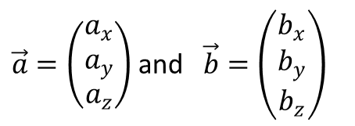
In Cartesian coordinates:
$\vec{a}=\left(\begin{matrix}a_{x} \\ a_{y} \\ a_{z}\end{matrix}\right)$ and $\vec{b}=\left(\begin{matrix}b_{x} \\ b_{y} \\ b_{z}\end{matrix}\right)$
$$\hat{i} •\hat{i} =1 \hat{j}•\hat{j}=1 \hat{k}•\hat{k}=1 \& \hat{i}•\hat{j}=0 \hat{i}•\hat{k}=0 \hat{j}•\hat{k}=0 \left(\cos{{90}^{0}=0}\right)$$
$\vec{a} • \vec{b}=\left(a_{x}\hat{i} + a_{y}\hat{j} + a_{z}\hat{k}\right)$ $•\left(b_{x}\hat{i} + b_{y}\hat{j} + b_{z}\hat{k}\right)$=
$$→ \vec{a} • \vec{b}=\left(\begin{matrix}a_{x} \\ a_{y} \\ a_{z}\end{matrix}\right)\left(\begin{matrix}b_{x} \\ b_{y} \\ b_{z}\end{matrix}\right)=a_{x}b_{x}+a_{y}b_{y}+a_{z}b_{z}$$

Slide 9



Properties of dot product
$$∎ \vec{a} • \vec{b}= \vec{b} • \vec{a}$$
$$∎ if \vec{a} and \vec{b} are parallel, then \vec{a} • \vec{b}= \left|\vec{a}\right|\left|\vec{b}\right|$$
$$∎ if \vec{a} and \vec{b} are antiparallel, then \vec{a} • \vec{b}=− \left|\vec{a}\right|\left|\vec{b}\right|$$
$$∎ \vec{a} • \vec{a}= {\left|\vec{a} \right|}^{2}$$
$$∎ \vec{a} •\left(\vec{b} + \vec{c}\right)=\vec{a}•\vec{b} + \vec{a}•\vec{c}$$
$$∎ \left(\vec{a}+\vec{b}\right) •\left(\vec{c}+\vec{d}\right)=\vec{a}•\vec{c} + \vec{a}•\vec{d}+\vec{b}•\vec{c} + \vec{b}•\vec{d}$$
$∎ \vec{a} • \vec{b}=0 \left(\vec{a} ≠0, \vec{b}≠0\right) ↔ \vec{a} and \vec{b} are perpendicular$

Slide 10
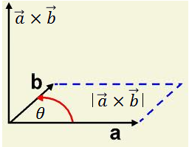




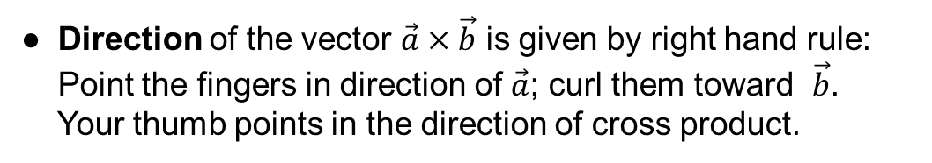
CROSS / VECTOR PRODUCT
Definition
● The magnitude of the vector $\vec{a}×\vec{b}$is equal
to the area determined by both vectors.
$$\left|\vec{a} ×\vec{b}\right|= \left|\vec{a}\right|\left|\vec{b}\right| sin θ$$
● Direction of the vector $\vec{a}×\vec{b}$ is given by right hand rule:
Point the fingers in direction of $\vec{a}$; curl them toward $\vec{b}$.
Your thumb points in the direction of cross product.
$$\vec{b}×\vec{a}=−\vec{a} ×\vec{b}$$

Slide 11

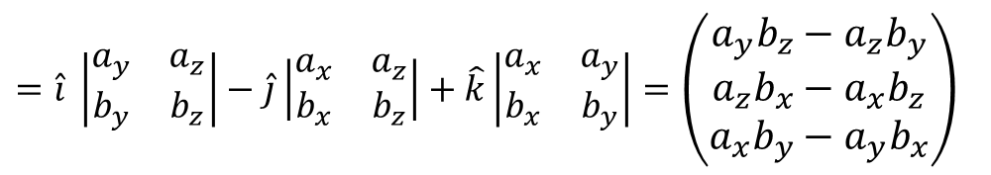
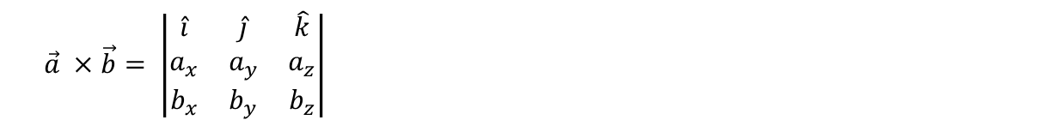




In Cartesian coordinates:
$$\hat{i}$$
$$\hat{j}$$
$$\hat{k}$$
Using properties of determinates
$$\left|\begin{matrix}a & b \\ c & d\end{matrix}\right|=ad−cb$$
We can write cross product in simple form:
$$+ − +$$
$$\vec{a} ×\vec{b}= \left|\begin{matrix}\hat{i} & \hat{j} & \hat{k} \\ a_{x} & a_{y} & a_{z} \\ b_{x} & b_{y} & b_{z}\end{matrix}\right|$$
$$=\hat{i} \left|\begin{matrix}a_{y} & a_{z} \\ b_{y} & b_{z}\end{matrix}\right|−\hat{j}\left|\begin{matrix}a_{x} & a_{z} \\ b_{x} & b_{z}\end{matrix}\right|+\hat{k}\left|\begin{matrix}a_{x} & a_{y} \\ b_{x} & b_{y}\end{matrix}\right|=\left(\begin{matrix}a_{y}b_{z}−a_{z}b_{y} \\ a_{z}b_{x}−a_{x}b_{z} \\ a_{x}b_{y}−a_{y}b_{x}\end{matrix}\right)$$

Slide 12


Properties of vector/cross product
$$∎ \vec{a} × \vec{b}=− \vec{b} × \vec{a}$$
$$∎ if \vec{a} and \vec{b} are perpendicular, then \left|\vec{a} × \vec{b}\right|= \left|\vec{a}\right|\left|\vec{b}\right|$$
$$∎ \vec{a} ×\left(\vec{b} + \vec{c}\right)=\vec{a}×\vec{b} + \vec{a}×\vec{c}$$
$$∎ \left(\vec{a}+\vec{b}\right) ×\left(\vec{c}+\vec{d}\right)=\vec{a}×\vec{c} + \vec{a}×\vec{d}+\vec{b}×\vec{c} + \vec{b}×\vec{d}$$
$$∎ \vec{a} × \vec{b}= 0 \left(\vec{a} ≠0, \vec{b}≠0\right) ↔ \vec{a} and \vec{b} are parallel$$
$For parallel vectors the vector product is 0.$

Slide 13


$$\vec{a} = 5\hat{i}−2\hat{j} +\hat{k}$$
$$\vec{b} = \hat{i}+\hat{j}−3\hat{k}$$
(a) Find the angle between them
(b) Find the unit vector perpendicular to both
(a) $θ=arc sin$ $\frac{\left|\vec{a} × \vec{b}\right|}{\left|\vec{a}\right|\left|\vec{b}\right|}$
$$\vec{a} ×\vec{b}=\left|\begin{matrix}\hat{i} & \hat{j} & \hat{k} \\ 5 & −2 & 1 \\ 1 & 1 & −3\end{matrix}\right|= 5\hat{i}+16\hat{j}+7\hat{k}$$
$$\left|\vec{a} × \vec{b}\right|=\left|5\hat{i}+16\hat{j}+7\hat{k}\right|=\sqrt{330}$$
$\left|\vec{a} \right|=\sqrt{30} \left|\vec{b} \right|=\sqrt{11}$
$$θ=arc sin 1 = π/2$$
(b) $\hat{n}=$ $\frac{\vec{a} ×\vec{b}}{\left|\vec{a} ×\vec{b}\right|}$ = $\frac{1}{\sqrt{330}}$ $\left(\begin{matrix}5 \\ 16 \\ 7\end{matrix}\right)$
Find all vectors perpendicular to both
$$\vec{a}=\left(\begin{matrix}1 \\ 2 \\ 3\end{matrix}\right) and \vec{b}=\left(\begin{matrix}3 \\ 2 \\ 1\end{matrix}\right)$$
$$\vec{a}×\vec{b}=\left|\begin{matrix}\hat{i} & \hat{j} & \hat{k} \\ 1 & 2 & 3 \\ 3 & 2 & 1\end{matrix}\right|=\left(\begin{matrix}−4 \\ 8 \\ −4\end{matrix}\right)$$
$$⤇ vector of the form k\left(\hat{i}−2\hat{j}+\hat{k}\right)$$
$where k is any non−zero real number.$

Slide 14

Find the area of the triangle with vertices A(1,1,3), B(4,-1,1), and C(0,1,8)
It is one-half the area of the parallelogram determined by the vectors
$\vec{AB}=\left(\begin{matrix}3 \\ −2 \\ −2\end{matrix}\right)$ and $\vec{AC}=\left(\begin{matrix}−1 \\ 0 \\ 5\end{matrix}\right)$
$$\frac{1}{2}\left|\vec{AB}×\vec{BC}\right|=\frac{1}{2}\left|\left|\begin{matrix}\hat{i} & \hat{j} & \hat{k} \\ 3 & −2 & −2 \\ −1 & 0 & 5\end{matrix}\right|\right| ⤇\frac{1}{2} \left|\left(\begin{matrix}−10 \\ −13 \\ −2\end{matrix}\right)\right|=\frac{1}{2} \sqrt{{(−10)}^{2}+{(−13)}^{2}+{(−2)}^{2}}$$
$=8.26 {units}^{2}$

Slide 15

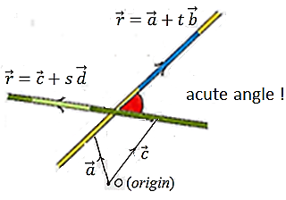
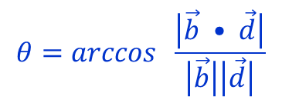


How do we use dot and cross product
• To find angle between vectors the easiest way is to use dot product, not vector product.
$$θ=arccos \frac{\vec{b} • \vec{d}}{\left|\vec{b}\right|\left|\vec{d}\right|}$$
• Angle between vectors can
be acute or obtuse
$$θ=arccos \frac{\left|\vec{b} • \vec{d}\right|}{\left|\vec{b}\right|\left|\vec{d}\right|}$$
• Angle between lines is by definition
acute angle between them, so
$\vec{b} and \vec{d}$ are direction vectors
Dot product of perpendicular vectors is zero.
• To show that two lines are perpendicular use the dot product with line direction vectors.
• To show that two planes are perpendicular use the dot product on their normal vectors.

Slide 16
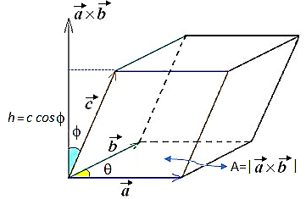
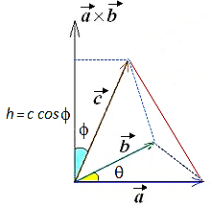
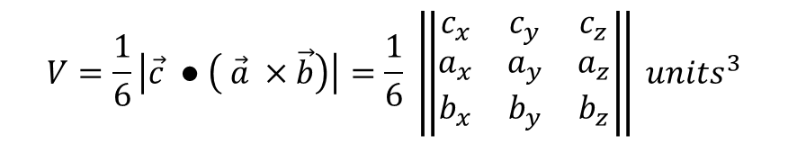
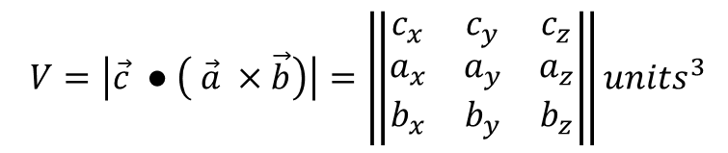
Volume of a parallelepiped = scalar triple product
$$V=\left|\vec{c} ● \left( \vec{a} ×\vec{b}\right)\right|=\left\|\begin{matrix}c_{x} & c_{y} & c_{z} \\ a_{x} & a_{y} & a_{z} \\ b_{x} & b_{y} & b_{z}\end{matrix}\right\|{units}^{3}$$
Volume of a tetrahedron = $\frac{1}{6}$ scalar triple product
$$V=\frac{1}{6}\left|\vec{c} ● \left( \vec{a} ×\vec{b}\right)\right|=\frac{1}{6} \left\|\begin{matrix}c_{x} & c_{y} & c_{z} \\ a_{x} & a_{y} & a_{z} \\ b_{x} & b_{y} & b_{z}\end{matrix}\right\| {units}^{3}$$
TEST FOR FOUR COPLANAR POINTS
$$▪ Four points are coplanar if and only if the volume of the tetrahedron$$
$defined by them is 0:$

Slide 17
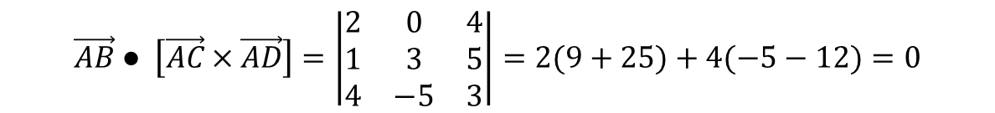


Are the points A(1, 2, -4), B(3, 2, 0), C(2, 5, 1) and D(5, -3, -1) coplanar?
$$\vec{AB}=\left(\begin{matrix}2 \\ 0 \\ 4\end{matrix}\right) \vec{AC}=\left(\begin{matrix}1 \\ 3 \\ 5\end{matrix}\right) \vec{AD}=\left(\begin{matrix}4 \\ −5 \\ 3\end{matrix}\right) ⤇$$
$$\vec{AB} ● \left[\vec{AC}×\vec{AD}\right]=\left|\begin{matrix}2 & 0 & 4 \\ 1 & 3 & 5 \\ 4 & −5 & 3\end{matrix}\right|=2(9+25)+4(−5−12)=0$$
$$∴ A, B, C and D are coplanar Q.E.D$$

Slide 18
lines
A line is completely determined by a fixed point and its direction.
Using vectors gives us a very neat way of writing down an equation which gives the position vector of any point P on a given straight line. This method works equally well in two or three dimensions.

Slide 19
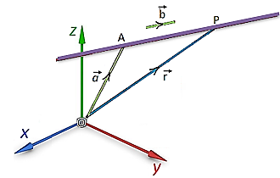

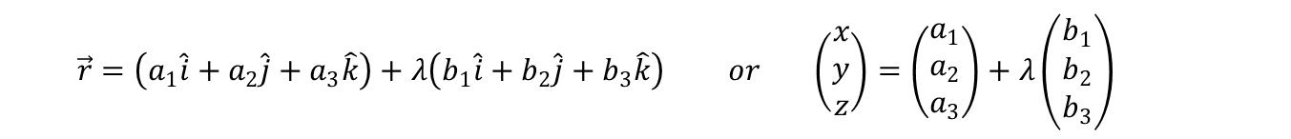
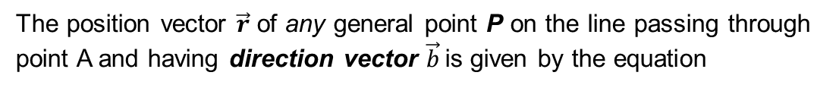

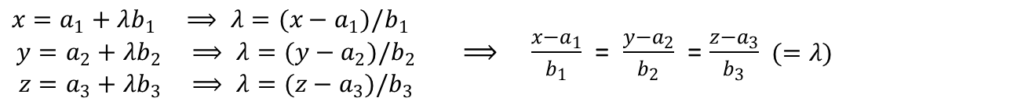
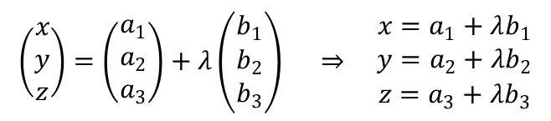
LINE EQUATION IN 2 – D and 3 – D COORDINATE SYSTEM
● Vector equation of a line
The position vector $\vec{r}$ of any general point P on the line passing through point A and having direction vector $\vec{b}$is given by the equation
$$\vec{r}=\vec{a}+t \vec{b} t∈R$$
IB Convention: $use t for 2−D line$
$λ for 3−D line$
$$\vec{r}=\left(a_{1}\hat{i}+a_{2}\hat{j}+a_{3}\hat{k}\right)+λ\left(b_{1}\hat{i}+b_{2}\hat{j}+b_{3}\hat{k}\right) or \left(\begin{matrix}x \\ y \\ z\end{matrix}\right)=\left(\begin{matrix}a_{1} \\ a_{2} \\ a_{3}\end{matrix}\right)+λ\left(\begin{matrix}b_{1} \\ b_{2} \\ b_{3}\end{matrix}\right)$$
● Parametric equation of a line – λ is called a parameter λ $∈ R$
$$\left(\begin{matrix}x \\ y \\ z\end{matrix}\right)=\left(\begin{matrix}a_{1} \\ a_{2} \\ a_{3}\end{matrix}\right)+λ\left(\begin{matrix}b_{1} \\ b_{2} \\ b_{3}\end{matrix}\right) ⇒ \begin{matrix}x=a_{1}+λb_{1} \\ y=a_{2}+λb_{2} \\ z=a_{3}+λb_{3}\end{matrix}$$
● Cartesian equation of a line
$\begin{matrix}x=a_{1}+λb_{1} ⟹ λ=(x−a_{1})/b_{1} \\ y=a_{2}+λb_{2} ⟹ λ=(y−a_{2})/b_{2} \\ z=a_{3}+λb_{3} ⟹ λ=(z−a_{3})/b_{3}\end{matrix}$ ⟹ $\frac{x−a_{1}}{b_{1}}$ =$\frac{y−a_{2}}{b_{2}}$ =$\frac{z−a_{3}}{b_{3}}$ $(=λ)$

Slide 20
Find the equation of the line passing through the points A(3, 5, 2) and B(2, -4, 5).
Find the direction of the line:
One possible direction vector is
The Cartesian equation of this line is
(using the coordinates f point A).
The equivalent vector equation is

Slide 21
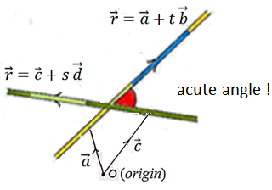

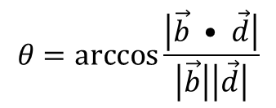
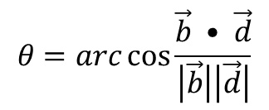
ANGLE BETWEEN TWO LINES
$$θ=\arccos{\frac{\left|\vec{b} • \vec{d}\right|}{\left|\vec{b}\right|\left|\vec{d}\right|}}$$
Two vectors
$$θ=arc\cos{\frac{\vec{b} • \vec{d}}{\left|\vec{b}\right|\left|\vec{d}\right|}}$$

Slide 22
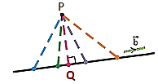



Shortest distance from a point to a line
Point P is at the shortest distance from the line
when PQ is perpendicular to $\vec{b}$
$$∴ \vec{PQ}•\vec{b}=0$$
Find the shortest distance between $\vec{r}=\left(\begin{matrix}1 \\ 3 \\ 1\end{matrix}\right)+λ\left(\begin{matrix}2 \\ 3 \\ 2\end{matrix}\right)$ and point P (1,2,3).
(The goal is to find Q first, and then $\left|\vec{PQ}\right|$)
Point Q is on the line, hence its coordinates must satisfy line equation:
$$\left(\begin{matrix}x_{Q} \\ y_{Q} \\ z_{Q}\end{matrix}\right)=\left(\begin{matrix}1+2λ \\ 3+3λ \\ 1+2λ\end{matrix}\right)⇒\vec{PQ}=\left(\begin{matrix}2λ \\ 1+3λ \\ −2+2λ\end{matrix}\right)$$
$$⇒\left(\begin{matrix}2λ \\ 1+3λ \\ −2+2λ\end{matrix}\right)•\left(\begin{matrix}2 \\ 3 \\ 2\end{matrix}\right)=0$$
$$⇒ 4λ+3+9λ−4+4λ=0 ⇒ 17 λ=1 ⇒λ=\frac{1}{17}$$
$⇒$ $\vec{PQ}=\left(\begin{matrix}2/17 \\ 20/17 \\ 32/17\end{matrix}\right) ⇒find \left|\vec{PQ}\right|$

Slide 23

Relationship between lines
2 – D:
3 – D:
● the lines are coplanar (they lie in the same plane). They could be:
▪ intersecting ▪ parallel ▪ coincident
● the lines are not coplanar and are therefore skew
(neither parallel nor intersecting)

Slide 24

$\vec{r_{1}}=\left[\begin{matrix}1 \\ 2 \\ 3\end{matrix}\right]+λ\left[\begin{matrix}4 \\ 5 \\ 6\end{matrix}\right]$ and $\vec{r_{2}}=\left[−\begin{matrix}1 \\ 2 \\ −1\end{matrix}\right]+μ\left[\begin{matrix}2 \\ 0 \\ 3\end{matrix}\right]$
$$.$$
Are the lines
∙ the same?…….check by inspection
∙ parallel?………check by inspection
∙ skew or do they have one point in common?
solving $\vec{r_{1}}=\vec{r_{2}}$will give 3 equations in λ and µ.
Solve two of the equations for λ and µ.
if the values of λ and µ do not satisfy the third equation then
the lines are skew, and they do not intersect.
If these values do satisfy the three equations then substitute the value
of λ or µ into the appropriate line and find the point of intersection.

Slide 25

Line 1: $x=−1+2s, y=1−2s, z=1+4s$
Line 2: $x=1−t, y=t, z=3−2t$
Line 3: $x=1+2u, y=−1−u, z=4+3u$
Show that lines 2 and 3 intersect and find angle between them
b) Show that line 1 and 3 are skew.
$1−t =1+2u ⇒t=−2u, t=−1−u ⇒ −2u=−1−u ⇒u=1 \& t=−2$
$$checking with z: 3−2t=4+3u ⇒3−2\left(−2\right)=4+3\left(1\right)$$
$confirmed intersection (3, −2, 7)$
$direction vectors for line 2 and line 3 are: \vec{b}=\left(\begin{matrix}−1 \\ 1 \\ −2\end{matrix}\right) and \vec{d}=\left(\begin{matrix}2 \\ −1 \\ 3\end{matrix}\right)$
$\cos{θ=}$ $\frac{\left|\vec{b} • \vec{d}\right|}{\left|\vec{b}\right|\left|\vec{d}\right|}= \frac{\left|−2−1−6\right|}{\sqrt{1+1+4}\sqrt{4+1+9}}=\frac{9}{\sqrt{84}} ⇒$ $θ≈{10.9}^{o}$
$$b) −1+2s=1+2u ⇒2s−2u=2, 1−2s=−1−u ⇒ −2s+u=−2, ⇒u=0 \& s=1$$
$$checking with z: 1+4s=4+3u ⇒1+4\left(1\right)=4+3\left(0\right) ⇒5≠4$$
$$⇒no simultaneous solution to all 3 equations$$
$∴the line do not meet, and as they are not parallel \left(\vec{b} ≠k\vec{d} , kεR\right) they must be skew.$

Slide 26





Distance between two skew lines
$$\vec{r}=\vec{a}+λ \vec{b} and \vec{r}=\vec{c}+μ \vec{d}$$
The cross product of $\vec{b}$ and $\vec{d}$ is perpendicular
to both lines, as is the unit vector:
$\hat{n}=$ $\frac{\vec{b}×\vec{d}}{\left|\vec{b}×\vec{d}\right|}$
The distance between the lines is then
$d=\left|\hat{n} •(\vec{c}−\vec{a})\right|$
(sometimes I see it, sometimes I don’t)

Slide 27





PLANE EQUATION
● Vector equation of a plane $\vec{r}=\vec{a}+λ \vec{b}+µ\vec{c}$
A plane is completely determined by two intersecting lines, what can be translated into a fixed point A and two nonparallel direction vectors
The position vector $\vec{r}$ of any general point P on the plane passing
through point A and having direction vectors $\vec{b}$ and $\vec{c}$ is given by the equation
$$\vec{r}=\vec{a}+λ \vec{b}+µ\vec{c} λ, µ∈R \left(\vec{AP}=λ \vec{b}+µ\vec{c}\right)$$
● Parametric equation of a plane: λ , μ are called a parameters λ,μ $∈ R$
$$\left(\begin{matrix}x \\ y \\ z\end{matrix}\right)=\left(\begin{matrix}a_{1} \\ a_{2} \\ a_{3}\end{matrix}\right)+λ\left(\begin{matrix}b_{1} \\ b_{2} \\ b_{3}\end{matrix}\right)+μ\left(\begin{matrix}c_{1} \\ c_{2} \\ c_{3}\end{matrix}\right) ⇒ \begin{matrix}x=a_{1}+λb_{1}+μc_{1} \\ y=a_{2}+λb_{2}+μc_{2} \\ z=a_{3}+λb_{3}+μc_{3}\end{matrix}$$
● Normal/Scalar product form of vector equation of a plane
$\vec{n}•\vec{r}= \vec{n}•\left(\vec{a}+λ \vec{b}+µ\vec{c}\right)$ ⇒ $\vec{r}•\vec{n}=\vec{a}•\vec{n} or \vec{n}•\left(\vec{r}−\vec{a}\right)= 0$
● Cartesian equation of a plane
$\vec{r}•\vec{n}=\vec{a}•\vec{n} ⤇ { n}_{1}x+n_{2}y+n_{3}z=n_{1}a_{1}+n_{2}a_{2}+n_{3}a_{3 }=d$
${ n}_{1}x+n_{2}y+n_{3}z=d$

Slide 28


$$Distance from origin:$$
$D= \left|\vec{r}•\hat{n}\right|=\left|\vec{a}•\hat{n}\right|$
$=$ $\frac{\left|\vec{a}•\vec{n}\right|}{\sqrt{n_{1}^{2}+n_{2}^{2}+n_{3}^{2}}}$ $=\frac{\left|n_{1}a_{1}+n_{2}a_{2}+n_{3}a_{3 }\right|}{\sqrt{n_{1}^{2}+n_{2}^{2}+n_{3}^{2}}}$

Slide 29

What does the equation 3x + 4y = 12 give in 2 and 3 dimensions?
https://www.osc-ib.com/ib-videos/default.asp
http://www.globaljaya.net/secondary/IB/Subjects%20Report/May%202012%20subject%20report/Maths%20HL%20subject%20report%202012%20TZ1.pdf

Slide 30











Find the equation of the plane passing through the three points P₁(1,-1,4), P₂(2,7,-1), and P₃(5,0,-1).
Find the equation of the plane with normal vector
$$\left(\begin{matrix}1 \\ 3 \\ 5\end{matrix}\right)$$
containing point (-2, 3, 4) .
$$\vec{b}=\vec{P_{1}P_{2}}= \left(\begin{matrix}1 \\ 8 \\ −5\end{matrix}\right) \vec{c}= \vec{P_{1}P_{3}}= \left(\begin{matrix}4 \\ 1 \\ −5\end{matrix}\right)$$
$one point on the plane is P_{1}=\left(\begin{matrix}1 \\ −1 \\ 4\end{matrix}\right)$
$$\left(\begin{matrix}1 \\ 3 \\ 5\end{matrix}\right)•\left(−2,3,4\right)=−2+9+20=27$$
$x+3y+5z=27$
vector form:
$$\vec{r}=\left(\begin{matrix}1 \\ −1 \\ 4\end{matrix}\right) +λ \left(\begin{matrix}1 \\ 8 \\ −5\end{matrix}\right)+µ\left(\begin{matrix}4 \\ 1 \\ −5\end{matrix}\right)$$
$\vec{r}●\left(\begin{matrix}3 \\ 2 \\ −4\end{matrix}\right)$ = 8
Find the distance of the plane
$$\vec{n}=\left|\begin{matrix}\hat{i} & \hat{j} & \hat{k} \\ 1 & 8 & −5 \\ 4 & 1 & −5\end{matrix}\right|=\left(\begin{matrix}−35 \\ −15 \\ −31\end{matrix}\right)$$
from the origin, and the unit vector perpendicular to the plane.
Any non-zero multiple of $\vec{n}$ is also
a normal vector of the plane. Multiply by -1.
$$\left|\left(\begin{matrix}3 \\ 2 \\ −4\end{matrix}\right) \right|=\sqrt{29}$$
$$\frac{1}{\sqrt{29}}\left[ \vec{r}●\left(\begin{matrix}3 \\ 2 \\ −4\end{matrix}\right)\right] = \frac{8}{\sqrt{29}}$$
$$D= \frac{8}{\sqrt{29}} \hat{n}= \frac{1}{\sqrt{29}}\left(\begin{matrix}3 \\ 2 \\ −4\end{matrix}\right)$$
$$\vec{n}=\left(\begin{matrix}35 \\ 15 \\ 31\end{matrix}\right)$$
$\left(\begin{matrix}35 \\ 15 \\ 31\end{matrix}\right)•\left(\begin{matrix}1 \\ −1 \\ 4\end{matrix}\right)=144$
$$Cartesian form:$$
$$35x+15y+31z=144$$

Slide 31






ANGLES
● The angle between a line and a plane
take acute angle
$$\sin{θ=\cos{φ}=} \frac{\left|\vec{n}•\vec{d}\right|}{\left|\vec{n}\right|\left|\vec{d}\right|}$$
$θ=arc sin$ $\frac{\left|\vec{n}•\vec{d}\right|}{\left|\vec{n}\right|\left|\vec{d}\right|}$
● The angle between two planes
The angle between two planes is the same
as the angle between their 2 normal vectors
$$\cos{θ=} \frac{\left|\vec{n}•\vec{m}\right|}{\left|\vec{n}\right|\left|\vec{m}\right|}$$
$$θ=arc cos{\frac{\left|\vec{n}•\vec{m}\right|}{\left|\vec{n}\right|\left|\vec{m}\right|}}$$

Slide 32

● INTERSECTION OF TWO or MORE PLANES

